Slide 1
Simulated pressure scans
01/08/2023

Slide 2
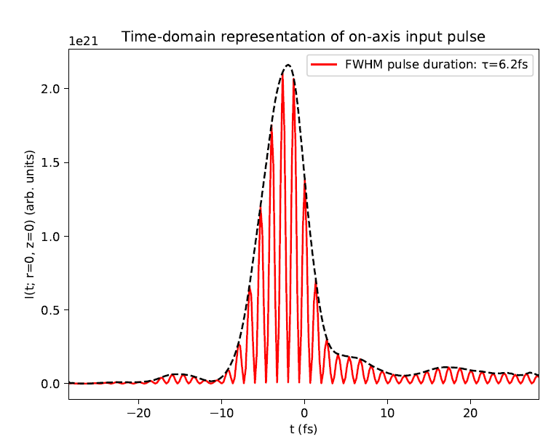
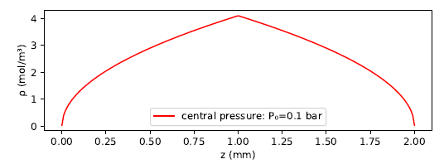
Simulation parameters
Input IR pulse based on measured FROG data
Spatial profile modelled as Gaussian
Simple gradient approximation for gas density, based on central and edge pressures

Slide 3
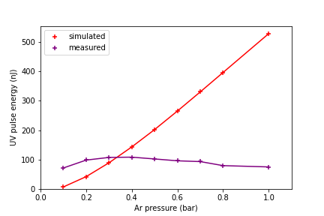
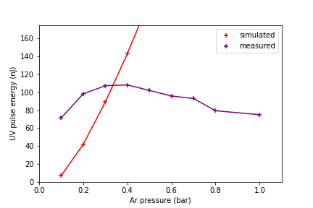
Pressure scan
Ran simulations for Argon and 150mW pulses with pressures ranging from 0.1 bar to 1.0 bar:
No saturation observed in simulations!
[zoomed]

Slide 4
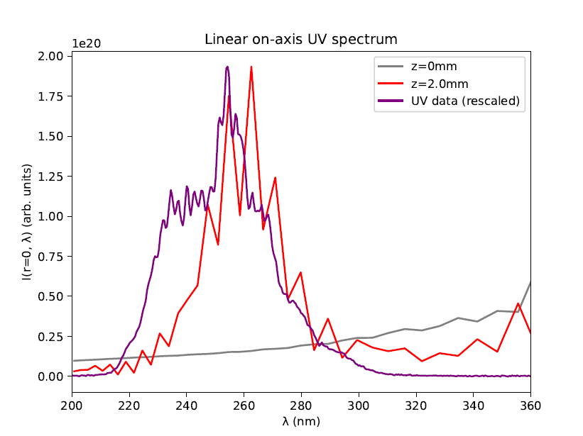
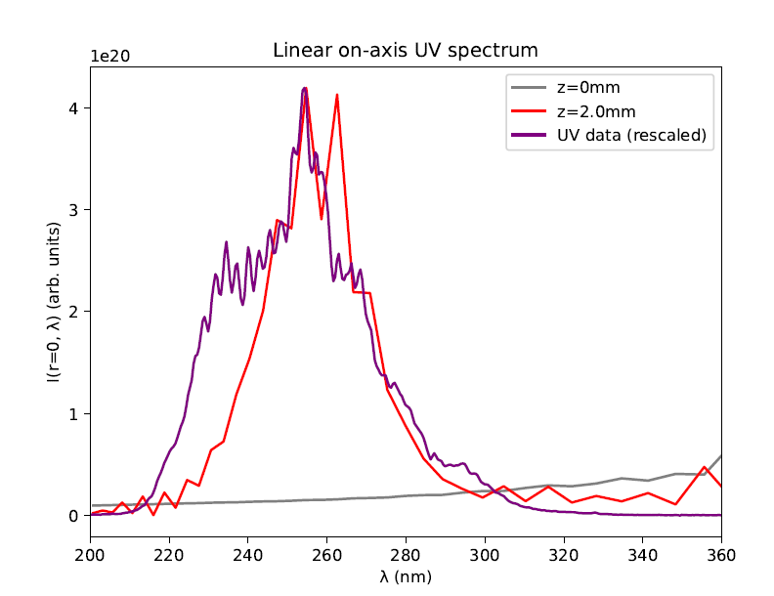
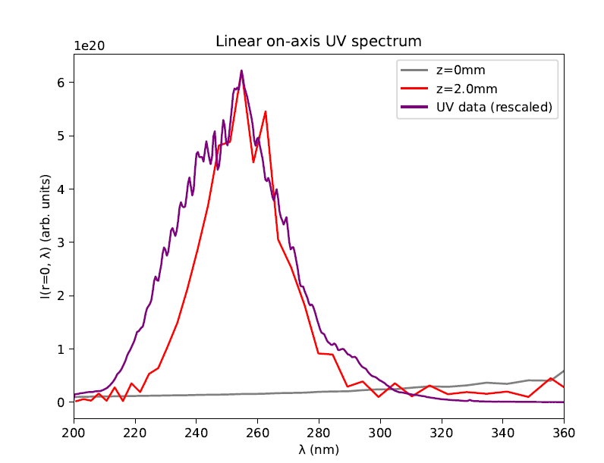
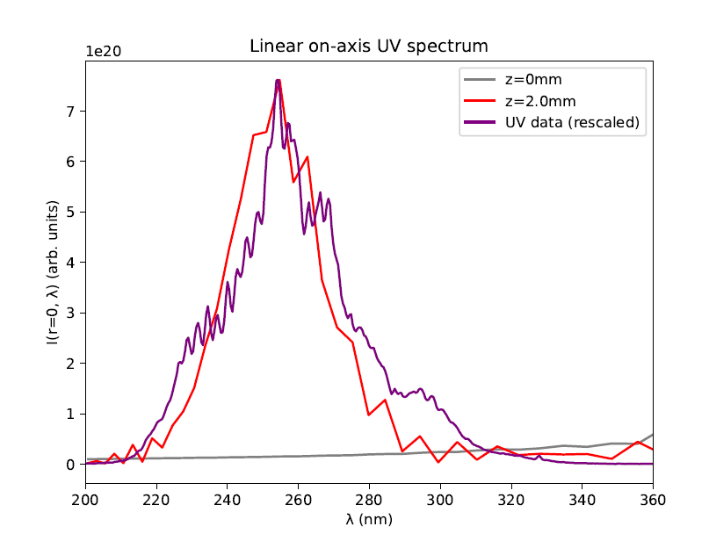
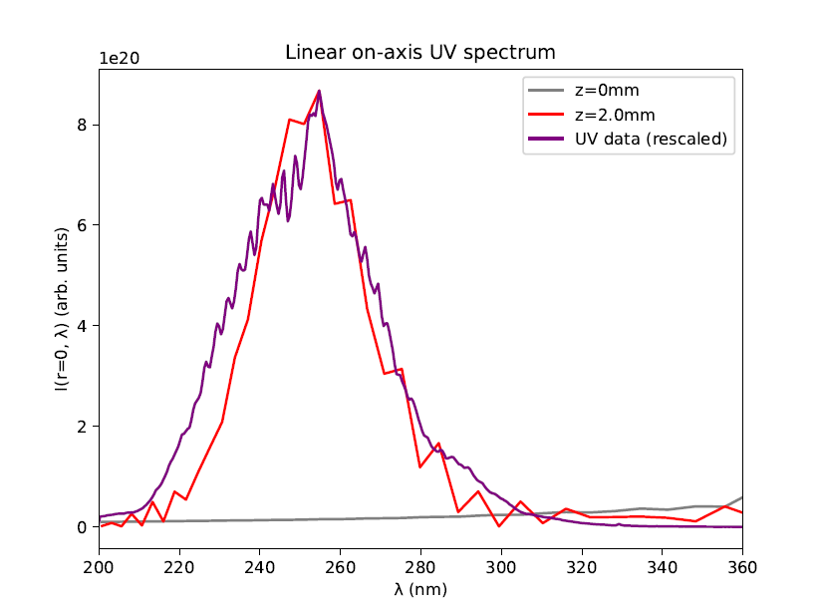
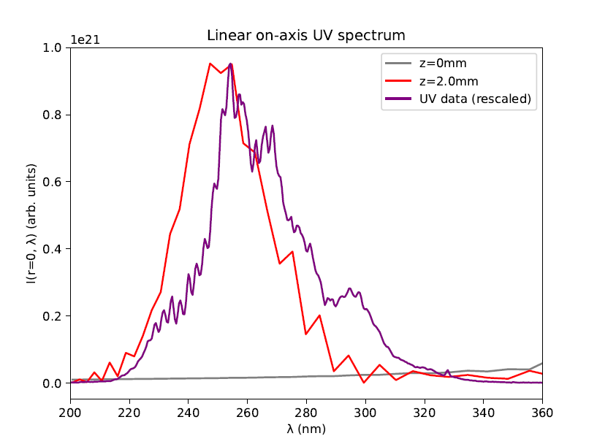
Spectra
0.1 bar
0.2 bar
0.3 bar
0.5 bar
0.4 bar
0.6 bar

Slide 5
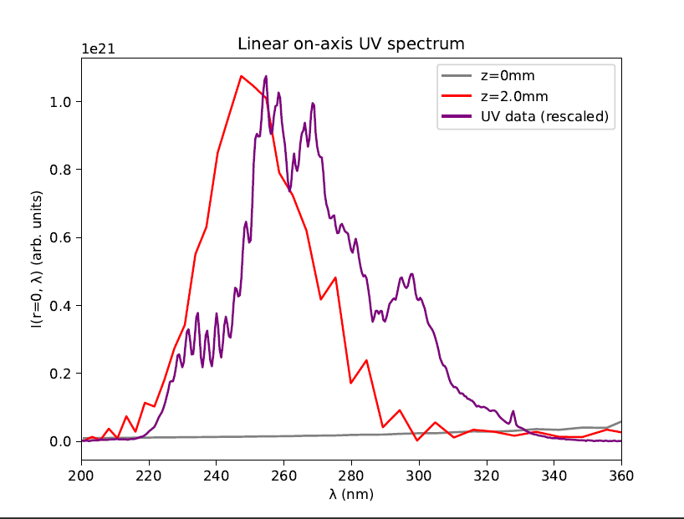
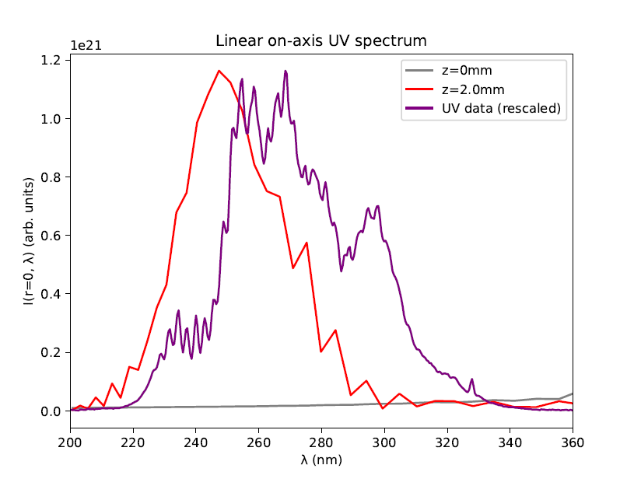
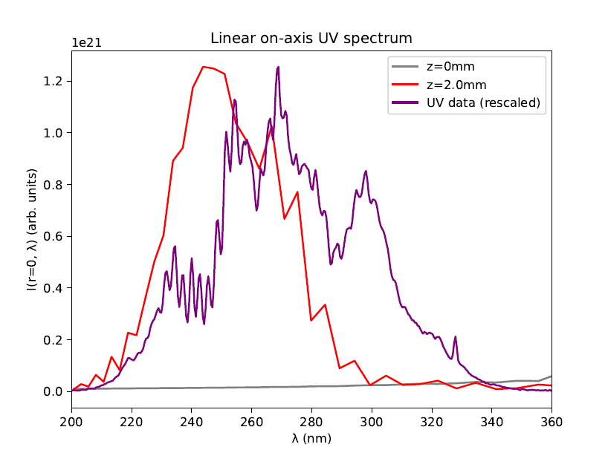
Spectra
0.7 bar
0.8 bar
1.0 bar
Additional spectral peaks not observed in simulations!

Slide 6
Conclusions
Divergence between simulated data and measurements
Especially at high pressures (for pulse energy also at low pressures)
Possible reason: breakdown of pressure gradient model
Try using COMSOL simulations of gas density instead
Alternative reason: nonlinear model incomplete
????

